Slide 1

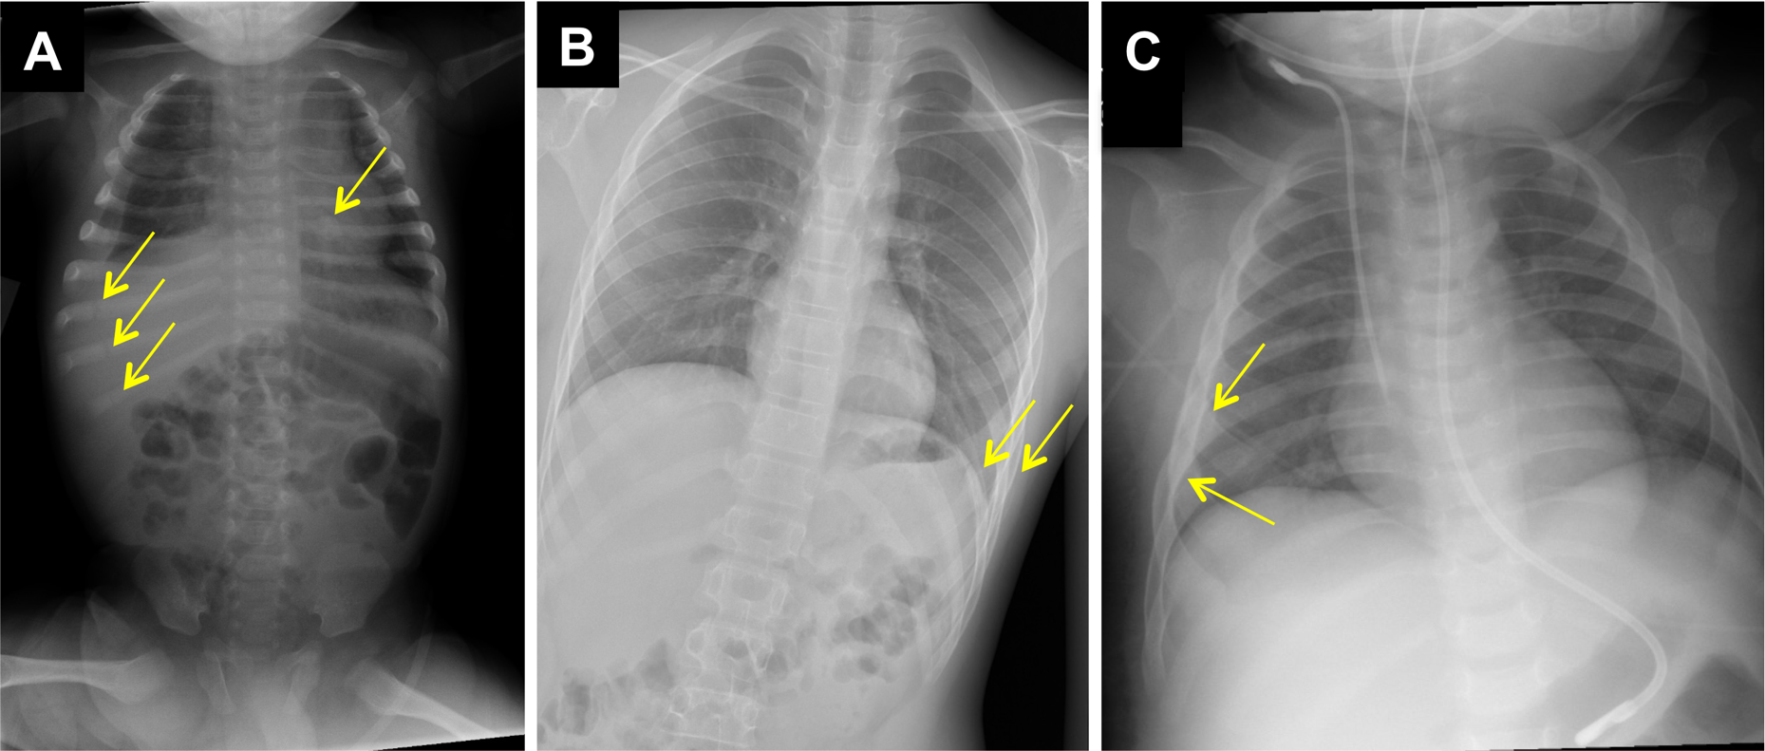
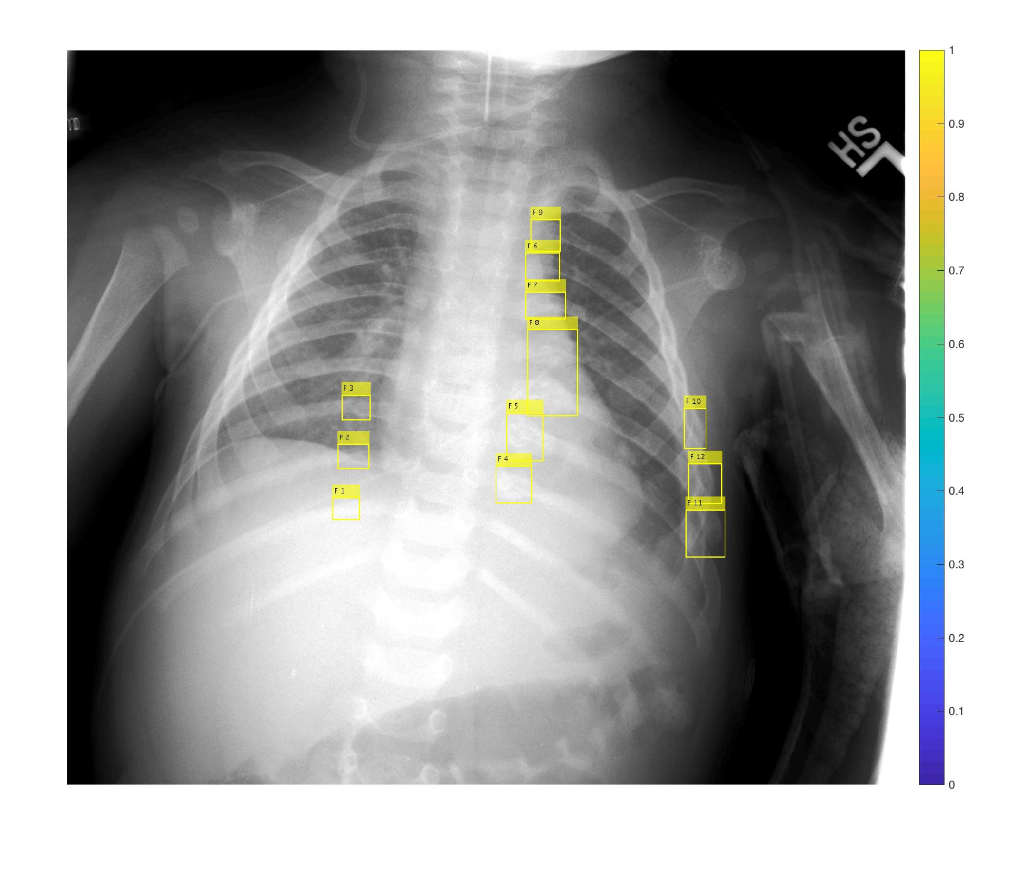
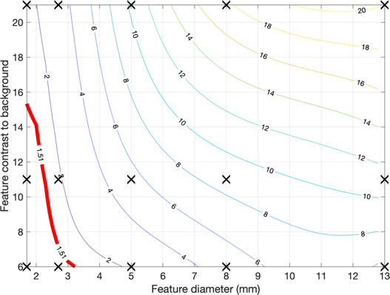
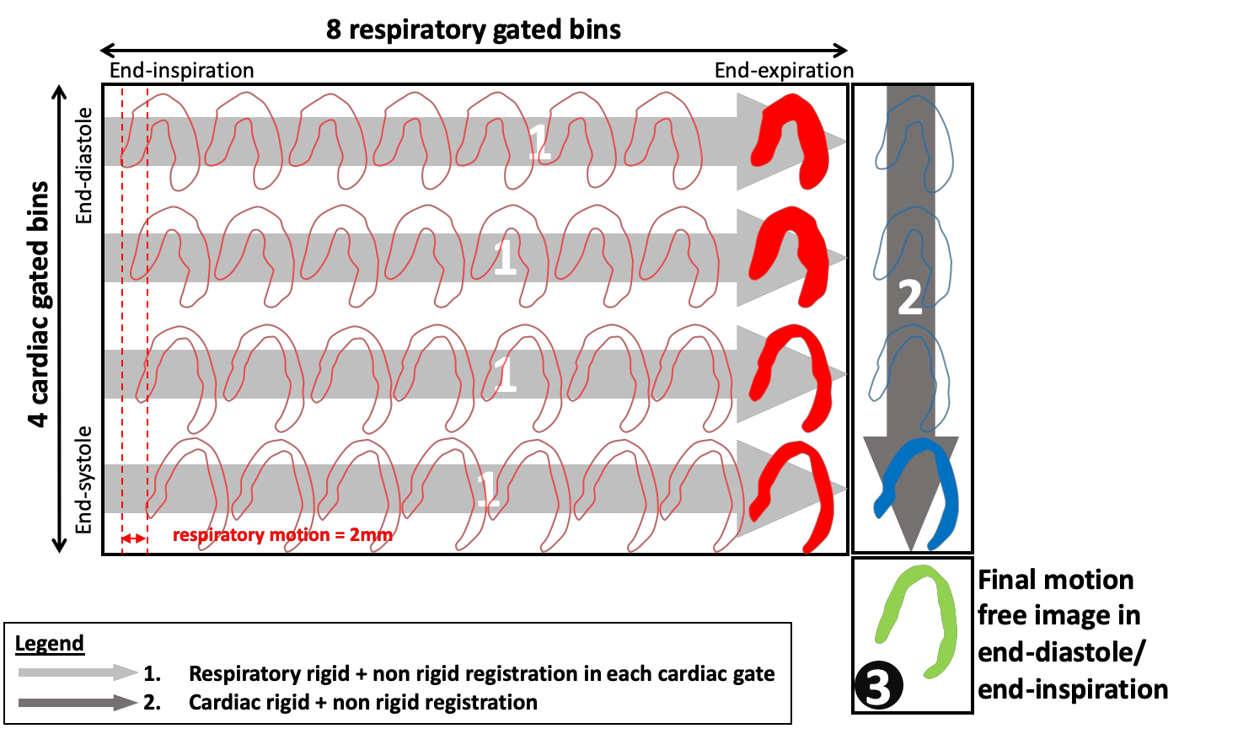

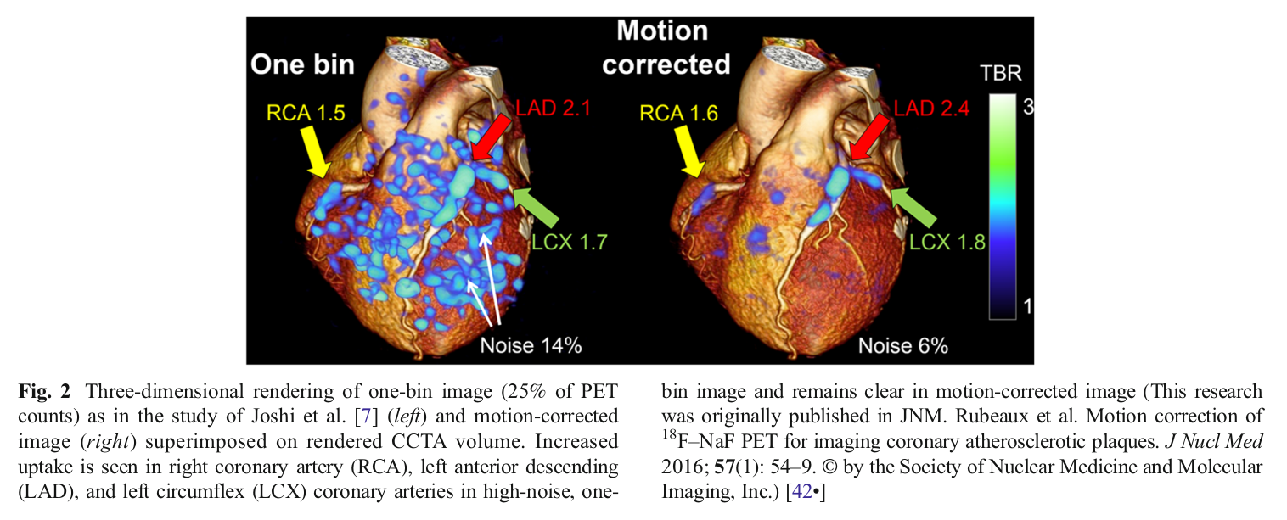
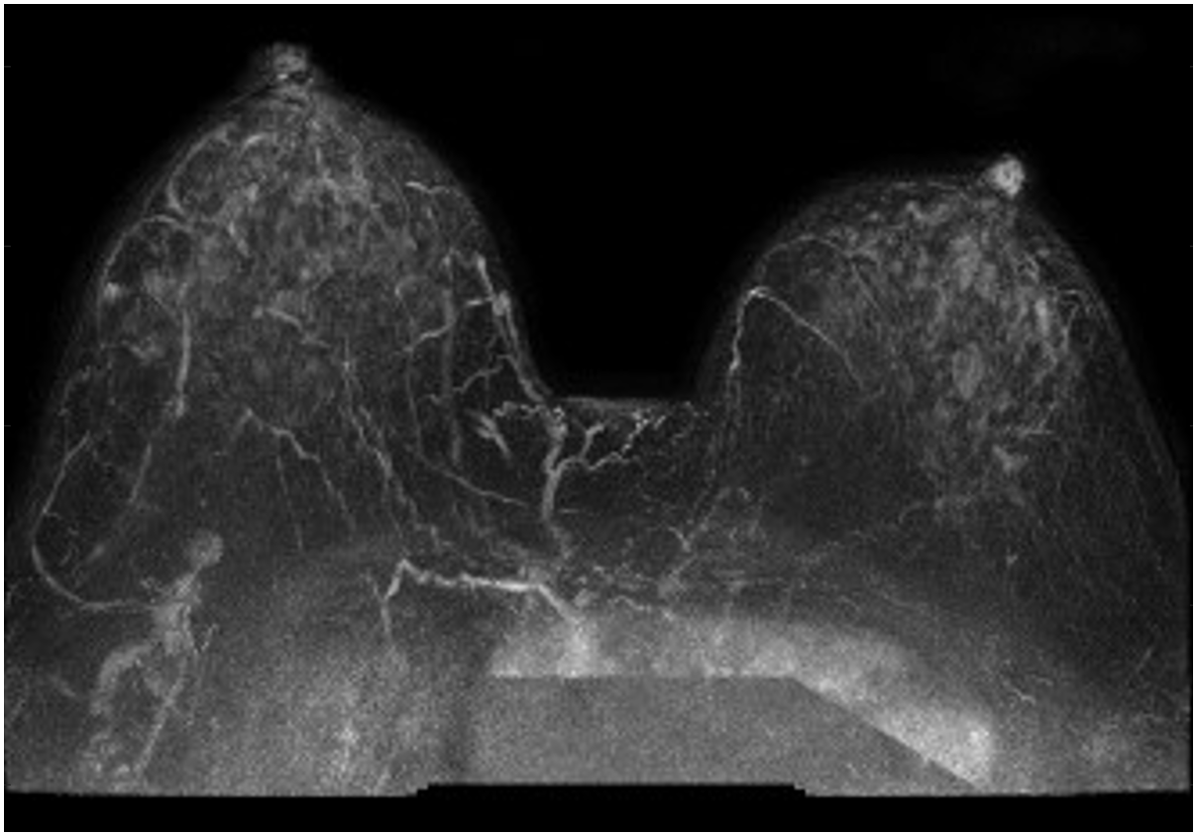
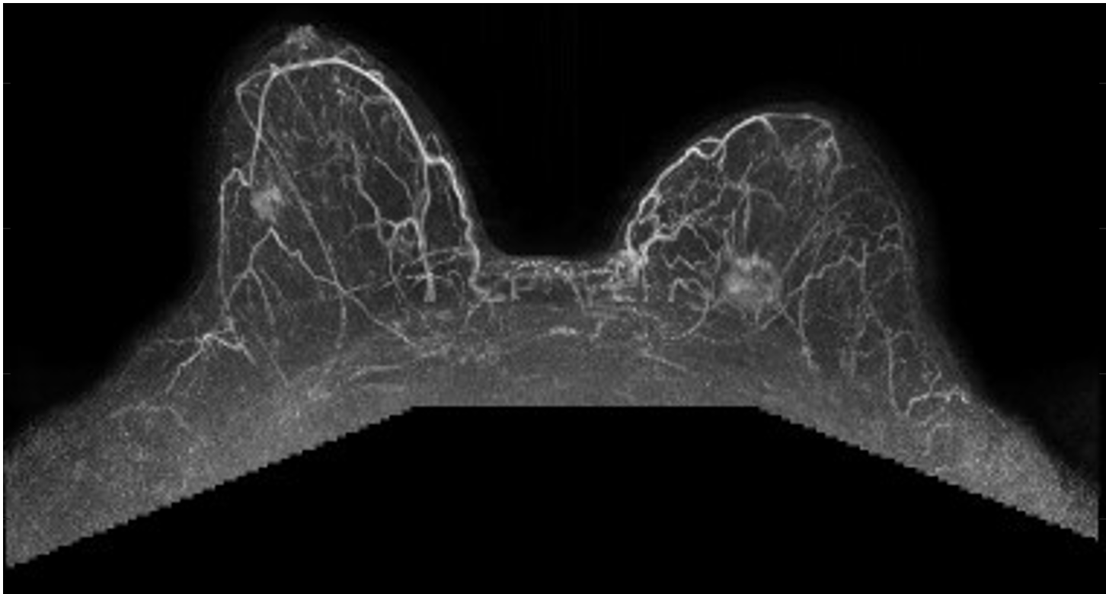
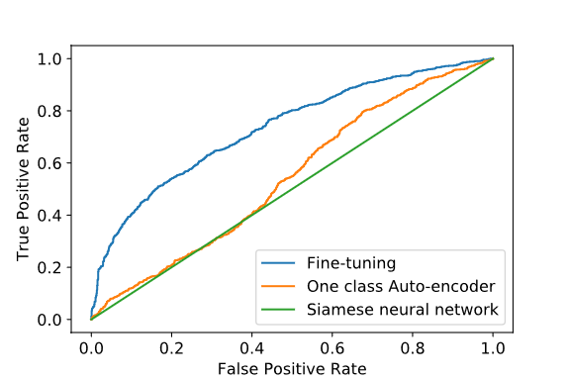
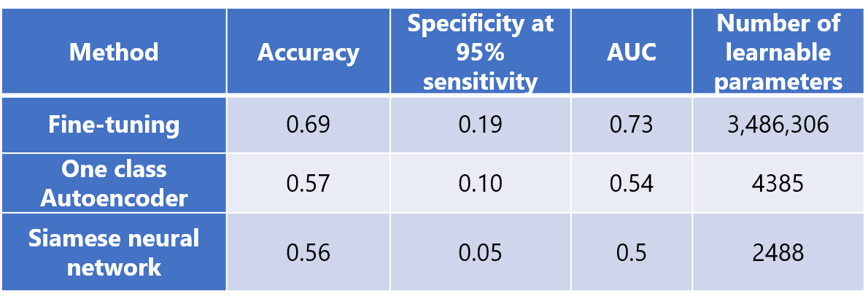



MIDI Lab
www.midilab.org
Cardiac Computed Tomography
Goal: Develop low-cost, non-invasive strategies using cardiac computed tomography to determine the root cause of myocardial ischemia.
Pediatric Rib Fracture Detection
Goal: Help identify non-accidental trauma through AI methods to automatically detect rib fractures on pediatric radiographs.
Coronary Plaque Imaging
Goal: Develop processing techniques to enable quantification of high-risk plaques in the coronary arteries with PET imaging of F18-FDG, F18-NaF, or other novel probes
Figure 1: Isocontour plot of the SUV max values for different contrast to background levels (y-axis) and different feature sizes (x-axis). The solid X markers highlight the measured values in this 2D space that were interpolated with cubic splines. The red curve marks the values at the background plus two standard deviations, highlighting the isocontour of detectability for features. For example, a 2mm feature would require a contrast of 14:1 to be visible with this scanning protocol.
Figure 1: Example stress state (row 1) and rest state (row 2) CT images acquired during multi-frame dynamic contrast enhancement for a single patient (color window=[-200,300] HU). The plot shows the myocardial TAC generated from the stress and rest states along with the model fit (dotted line).
Figure 2: Illustration of dual-respiratory/cardiac motion correction (MC) technique consisting of decoupled respiratory then cardiac motion correction.
Figure 1: A chest radiograph with arrows to locations of potential rib fractures (left). These fractures are challenged to detect. An automated model analyzes these types of images to detect fractures with an example case on the right.
Collaborators:
Seattle Children’s Hospital: Drs. Otjen and Bindschadler
R21HD097609, Automatic Rib Fracture Detection in Pediatric Radiography to Identify Non-Accidental Trauma
Figure 2: Scatter plot comparing novel CT myocardial blood flow estimates to conventional PET blood flow estimates. The resting state estimates are presented in circle markers, and the stress state in square markers. Each patient has a unique color. (SEE=Standard Error of Estimates).
Medical Imaging and
Data Integration Laboratory
Figure 3: 3D rendering of one-bin image (25% of PET counts) of a custom F18-NaF PET/CT scan (left), and motion-corrected image (right) superimposed on rendered CCTA volume. Increased uptake is seen in right coronary artery, left anterior descending, and left circumflex coronary arteries in high-noise, one-bin image and remains clear in motion-corrected image. (Rebeaux et al. Motion correction of ¹⁸F-NaF PET for imaging coronary atherosclerotic plaques. J Nucl Med 2016; 57(1): 54-9. © by the Society of Nuclear Medicine and Molecular Imaging, Inc.)
Collaborators:
University of Washington: Drs. Branch, Caldwell, and Feigl
R01HL109327, Low-dose strategies for Myocardial Blood Flow Estimation from Dynamic CT
R56HL109327, Quantitative CT Evaluation of Focal Epicardial vs Diffuse Contributions to Coronary Artery Disease
Collaborators:
Cedars-Sinai: Drs. Piotr Slomka and Martin Lassen
1R01HL135557, Integrated Analysis of Coronary Anatomy and Biology using 18F-fluoride PET and CT Angiography
PET Image Reconstruction
Goal: Develop image generation algorithms for PET/CT and PET/MR to provide accurate and precise quantitation of radiopharmaceutical concentrations
MISSION: Our lab advances the analysis and integration of medical imaging and biomedical data for targeted, precise healthcare. Current efforts focus on creative applications of artificial intelligence and improved image generation and detection from high dimensional tomographic data. We seek to integrate physiologic models, imaging system models, and patient phenotypes into unified computational models for improved diagnostic information.
Breast MRI
Goal: Risk stratify breast cancer based on dynamic contrast MR exams and additional patient factors
Adam Alessio
Professor
Computational Mathematics Science and Engineering (CMSE)
Biomedical Engineering (BME)
Radiology
Institute for Quantitative Health Science & Engineering (IQ)
Benign
Malignant
Current Lab Members (Feb 2020):
Joe Adams
Lab Manager
Mohamed Abouhawwash, PhD
Postdoctoral Fellow
Graduate Students:
Jonathan Burkow, CMSE
Muneeza Azmat, CMSE
Ethan Tu, BME
Sydney Rubin, CHM
Undergraduate Students:
Greg Holste, Math
Peter Carras, Statistics
Raymond Lesiyon, BAE
Karletta Hammond, EE
Figure 1: Example dynamic contrast enhanced MRI images obtained by injecting contrast into patient’s blood stream and capturing a series of MRI volumes. The image volumes are subtracted before and after contrast.
Figure 2: ROC for Three different methods for identifying the presence of a breast nodule were compared:
Fine-tuning pre-trained neural network (ResNet50)
Siamese neural network
One class auto encoder
The accuracy, specificity at 95% sensitivity, and AUC were all used as metrics to quantify the success of the three methods.
Figure 1: Contrast recovery coefficient plotted against “true” noise for 35 cm background ROI. Error bars denote standard deviation in CRC across 50 realizations. The circles mark the end of 4 and 8 iterations
Figure 2: Two transaxial slices from OSEM+LOR (row 1), OSEM+LOR+3 mm postfilter (row 2), and OSEM+LOR+PSF (row 3). All images have matched color scales and row 2 and row 3 have matched pixel-to-pixel variability in central white matter
Contact Us
Institute for Quantitative Health Sciences and Engineering
775 Woodlot Drive, Rm 1116,
East Lansing, MI, 48824
https://www.midilab.org/
aalessio@msu.edu
Collaborators: University of Washington: Paul Kinahan and Darrin Byrd GE Healthcare: Charles Stearns, Scott Wollenweber, Steven Ross
K25-HL086713, Quantitative Cardiac PET/CT Imaging
Collaborators:
Seattle Cancer Care Alliance: Drs. Savannah Partridge and Christoph Lee
Notes:
1
1

